Slide 1

Physical activity across the cancer continuum: epidemiology and biologic mechanisms
Christine Friedenreich, PhD, FCAHS, FRSC
Scientific Director, Cancer Epidemiology and Prevention Research
Alberta Health Services
Adjunct Professor, Cumming School of Medicine and Kinesiology
University of Calgary
IARC Distinguished Speaker Series, June 18, 2020

Slide 2


Physical Activity in Cancer Control Framework
Cancer Control Categories
Courneya & Friedenreich (2001, 2007)
Diagnosis
Prevention
Detection
Treatment Prep/Coping
Treatment Effectiveness/Coping
Recovery Rehabili-tation
Disease Prevention/ Health
Promotion
Survival
Palliation
Prescreening
Screening
Pretreatment
Treatment
Survivorship
End-of-Life
Pre-diagnosis
Post-diagnosis
Cancer-Related Time Periods
Courneya and Friedenreich, 2001 and 2007
Notes:
Prevention
Exercise reduces risk of 13 cancers
Detection
acute exercise raised PSA levels (shouldn’t exercise prior to screening tests)
Exercise may reduce anxiety/stress associated with screening tests (0 studies have been done)
Cancer Buffering
exercise may “build up” patients physical, function, and psychological reserve to begin treatment in the best possible condition
Lung cancer patients who exercised had fewer complications post-surgery
Lung cancer patients who exercised had more hope/power over lives compared to non-exercisers
Cancer Coping
Exercise during treatment (17 studies) have been found to be safe, feasible, improve functional capacity, muscular
strength, body composition (e.g., BMI), sleep patterns, less nausea and fatigue, improved body satisfaction, and mood
states (e.g., less depression and anxiety) (Found to improve quality of life)
Cancer Rehabilitation
useful if the post-treatment diagnosis was successful; function is to restore the person back to a condition of good health; exercise may help patients recover from the side effects of treatment (e.g., muscle loss, etc…)
two studies have shown that exercise improves functional capacity of patients compared to controls
Cancer and Health Promotion
Goal is to optimize the health of the patient
Research has shown improvements in functional capacity, body composition, mood states, perceived physical competence, body image, self-esteem, and general QOL
Cancer Palliation
physical exercise may help patients maintain functional independence and QOL for as long as possible
Case-control study(continued to live independently until her death)
Survival
exercise may increase length of survival after a cancer diagnosis and treatments
1 study found no relationship between recreational physical activity and cancer survival (didn’t assess occupational activity which Friedenreich found to be more important in BC survivors than recreational)

Slide 3







Current Attributable Cancer Incidence Burden in Canada
Team: Friedenreich, Brenner (co-PIs), King, Franco, Walters, De
www.prevent.cancer.ca

Slide 4

Preventable cancers: physical activity and all associated cancer ses
Friedenreich, et al. Prev Med 2019;122:65-72

Slide 5
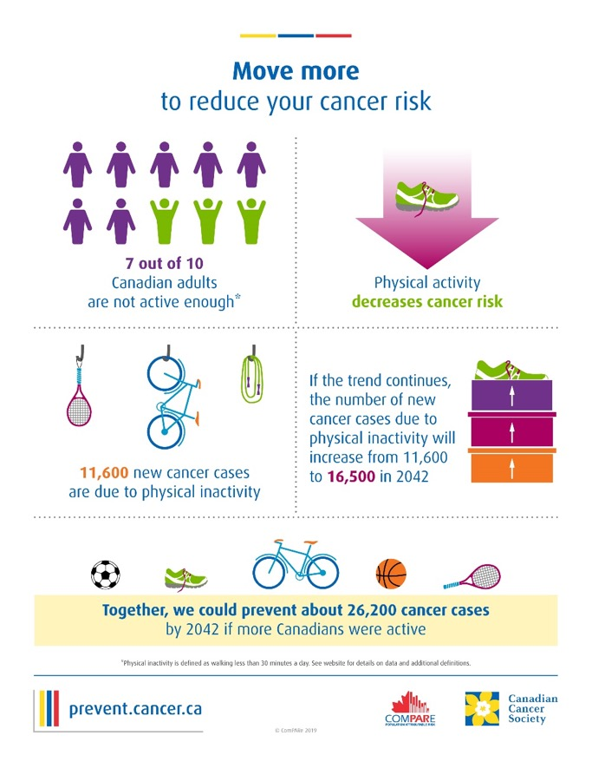
Current Attributable Cancer Incidence Burden in Canada
Team: Friedenreich, Brenner (co-PIs), King, Franco, Walters, De
Current Burden Attributable to Physical Inactivity:
7 out of 10 Canadian adults are not active enough
11,600 new cancer cases are due to physical inactivity
If trends continue to 2042 there will be 16,500 cases due to physical inactivity
Friedenreich, et al. Prev Med 2019;122:65-72

Slide 6

Physical activity and cancer incidence
Site | No. of studies | No. of estimates | Estimate | 95% CI | I² | Dose-response effect
Bladder | 17 | 21 | 0.85 | 0.76-0.81 | 78.3% | 3 of 11
Breast | 142 | 148 | 0.78 | 0.73-0.81 | 81.9% | 63 of 109
Colorectal | 118 | 137 | 0.76 | 0.73-0.79 | 71.7% | 54 of 79
Endometrial | 35 | 35 | 0.76 | 0.71-0.81 | 24.9% | 16 of 26
Esophageal | 14 | 16 | 0.63 | 0.49-0.81 | 84.2% | 4 of 8
Kidney | 25 | 33 | 0.84 | 0.74-0.95 | 68.9% | 4 of 21
Lung | 43 | 50 | 0.78 | 0.72-0.83 | 83.9% | 15 of 23
Ovarian | 28 | 30 | 0.87 | 0.77-0.98 | 64.7% | 9 of 17
Pancreatic | 29 | 38 | 0.82 | 0.75-0.91 | 47.4% | 9 of 25
Prostate | 69 | 69 | 0.92 | 0.87-0.97 | 75.5% | 17/45
Updated to May 2020

Slide 7

Exercise interventions during and after treatment

Slide 8



Cancer-related health outcomes with sufficient evidence for FITT prescription
Strong Evidence for:
Moderate evidence for:
Physical Function
Health-related QoL
Lymphedema
Bone health
Sleep
Insufficient evidence for:
Fatigue
Cardiotoxicity
Chemotherapy induced peripheral neuropathy
Cognitive function
Falls
Nausea
Pain
Sexual function
Treatment tolerance
Depressive
Symptoms
Anxiety
Campbell KL et al. MSSE 2019 Nov;51(11):2375-2390

Slide 9

Physical activity and cancer survival
Chelsea Stone, MSc, Kananaskis Park, Alberta, Canada

Slide 10



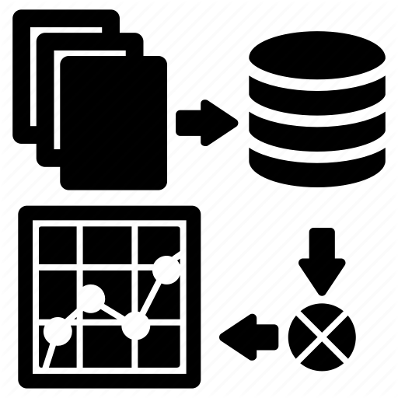
Physical activity and cancer mortality:
a systematic review and meta-analysis
By the numbers:
15,760 records identified in 3 databases
136 included studies through November 1, 2018 and updated to February 23, 2020 with 12 more studies
Publication dates 1992-2020
Methods:
Random-effects models
Dose-response curves
Friedenreich CM, Stone CR, Cheung W, Hayes S. JNCI-CS 2020; 4(1), pkz080
Notes:
* Pubmed, EMBASE and Sportdiscus
Random effects used to acknowledge the inherent heterogeneity in the populations

Slide 11
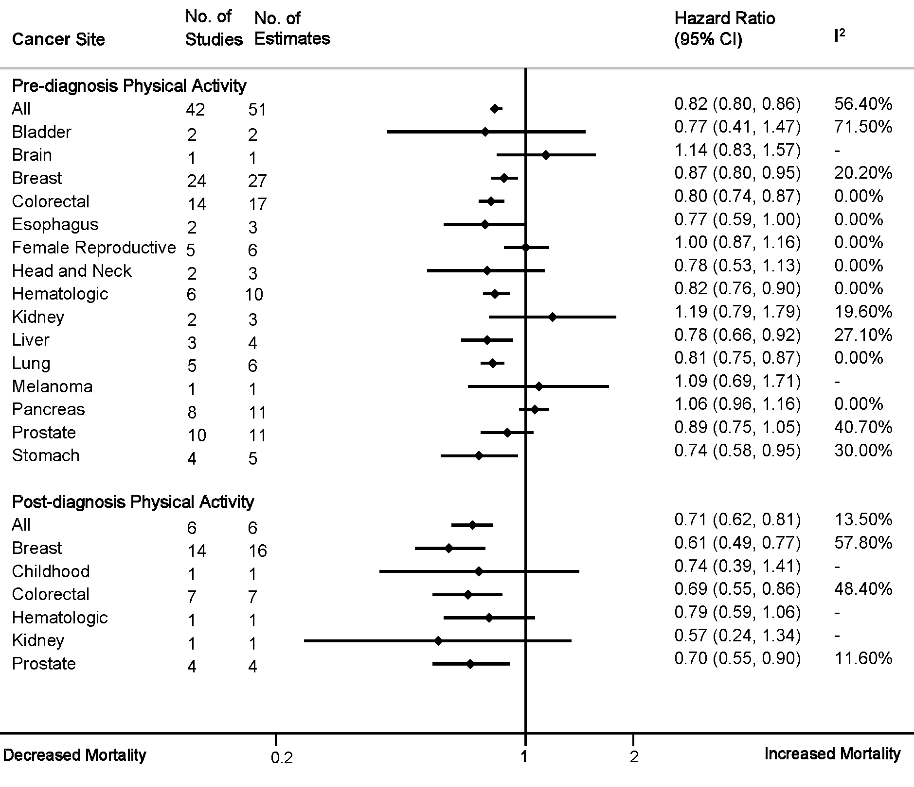
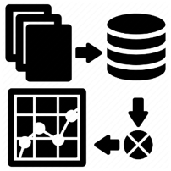
Physical activity and
cancer-specific mortality
A systematic review and meta-analysis
Friedenreich et al., JNCI-CS 2020 (Updated: May 2020)

Slide 12
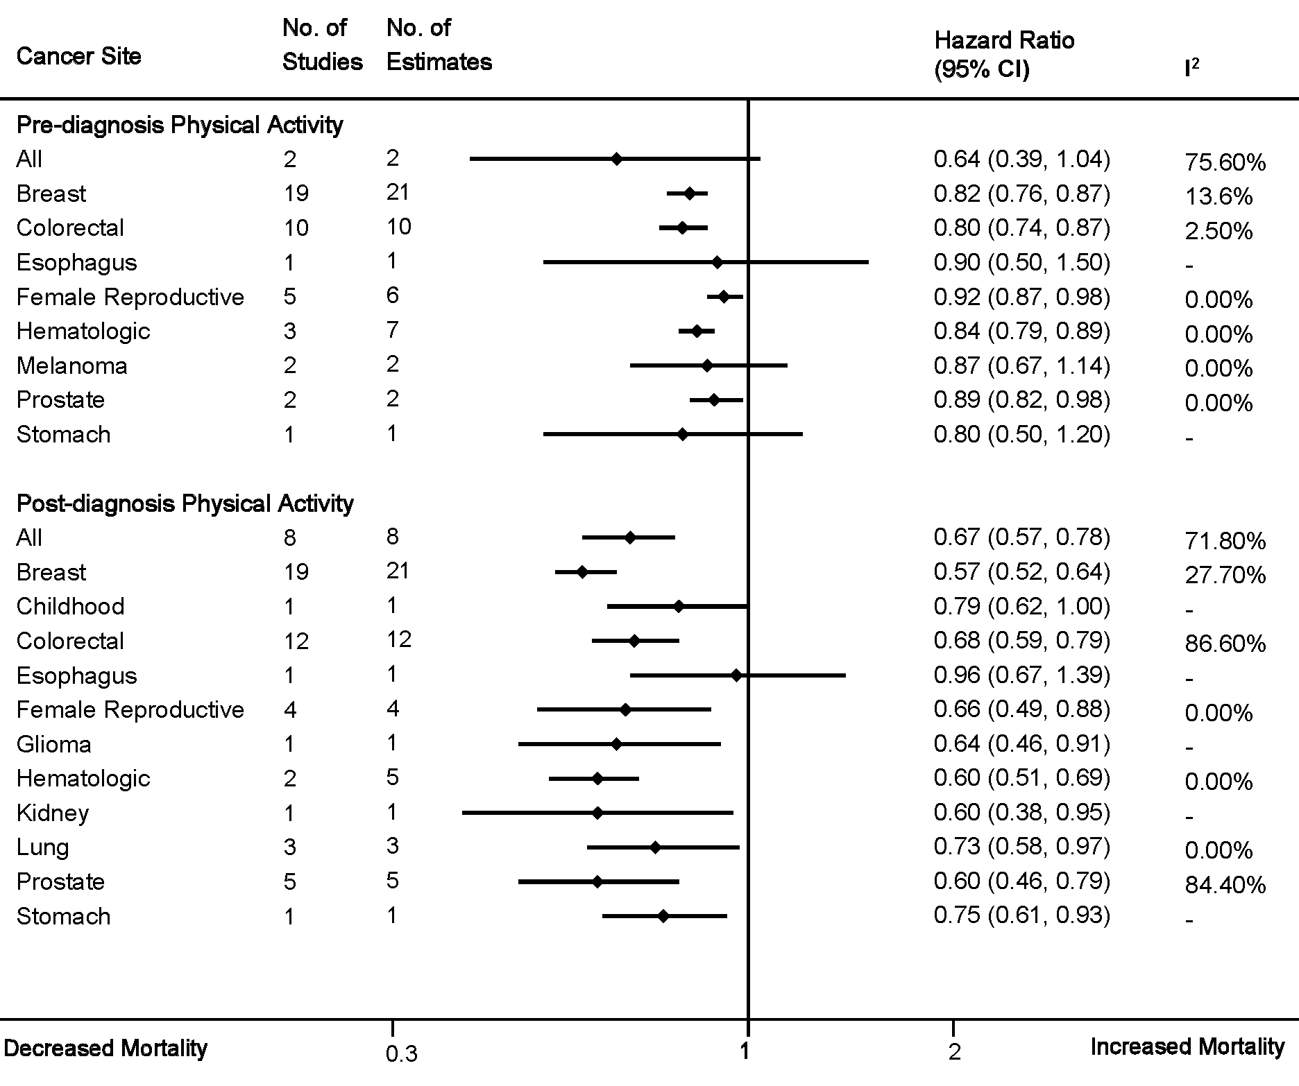
Physical activity &
all-cause mortality
(in cancer survivors)
A systematic review and meta-analysis
Friedenreich et. al. JNCI-CS 2020 (Updated: May 2020)

Slide 13
Summary of findings
A systematic review and meta-analysis
Cancer-specific mortality
All-cause mortality
Pre-diagnosis | Post-diagnosis
All cancers | All cancers
Breast | Breast
Colorectal | Colorectal
Esophageal | Prostate
Hematologic
Liver
Lung
Stomach
Pre-diagnosis | Post-diagnosis
All cancers | All cancers
Breast | Breast
Colorectal | Colorectal
Hematologic | Female reproductive
Prostate | Glioma
 | Kidney
 | Lung
 | Prostate
 | Stomach
Friedenreich et al., JNCI-CS 2020; 4(1), pkz080 2020

Slide 14

Breast cancer: dose-response
A. Pre-diagnosis PA and all-cause mortality
B. Post-diagnosis PA and all-cause mortality
A
B
Hazard Ratio
Hazard Ratio
MET-hr/wk
MET-hr/wk
C. Pre-diagnosis PA and cancer-specific mortality
D. Post-diagnosis PA and cancer-specific mortality
C
D
Hazard Ratio
Hazard Ratio
Friedenreich et al., 2020
MET-hr/wk
MET-hr/wk
Notes:
Completed on sites where there were enough estimates (>5) to complete these analyses.
Less precise estimates at the higher PA levels because fewer individuals were completing this level of activity.

Slide 15
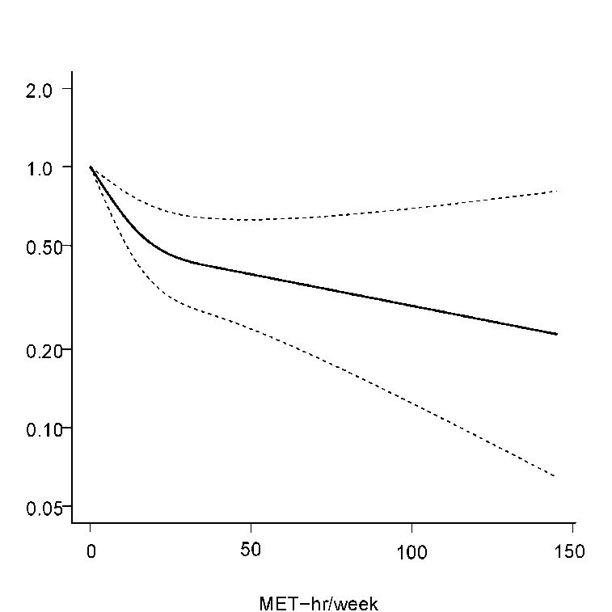
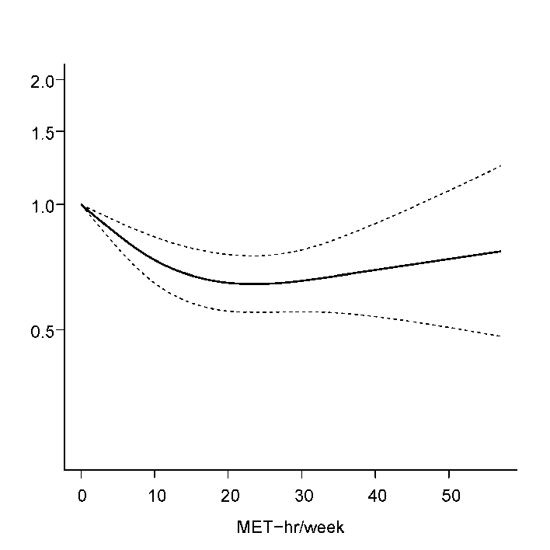

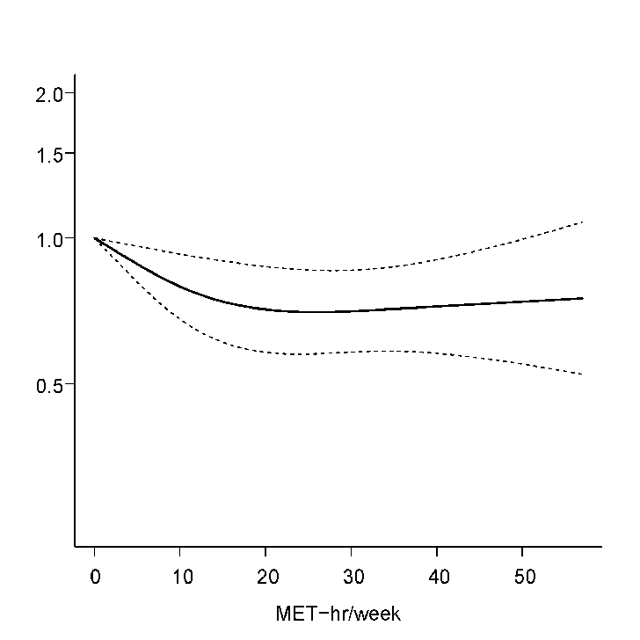
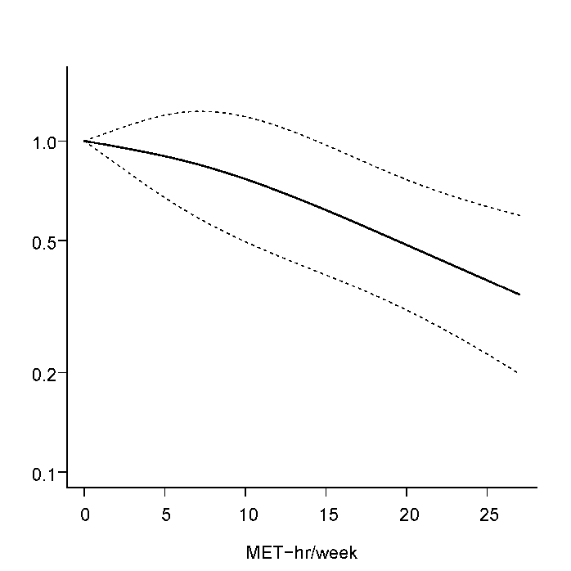
Colorectal cancer: dose-response
A. Pre-diagnosis PA and all-cause mortality (n=5)
B. Post-diagnosis PA and all-cause mortality (n=6)
Hazard Ratio
Hazard Ratio
MET-hr/wk
MET-hr/wk
C. Pre-diagnosis PA and cancer-specific mortality (n=6)
D. Post-diagnosis PA and cancer-specific mortality (n=4)
Hazard Ratio
Hazard Ratio
MET-hr/wk
MET-hr/wk
Notes:
Completed on sites where there were enough estimates (>5) to complete these analyses.
Less precise estimates at the higher PA levels because fewer individuals were completing this level of activity.

Slide 16
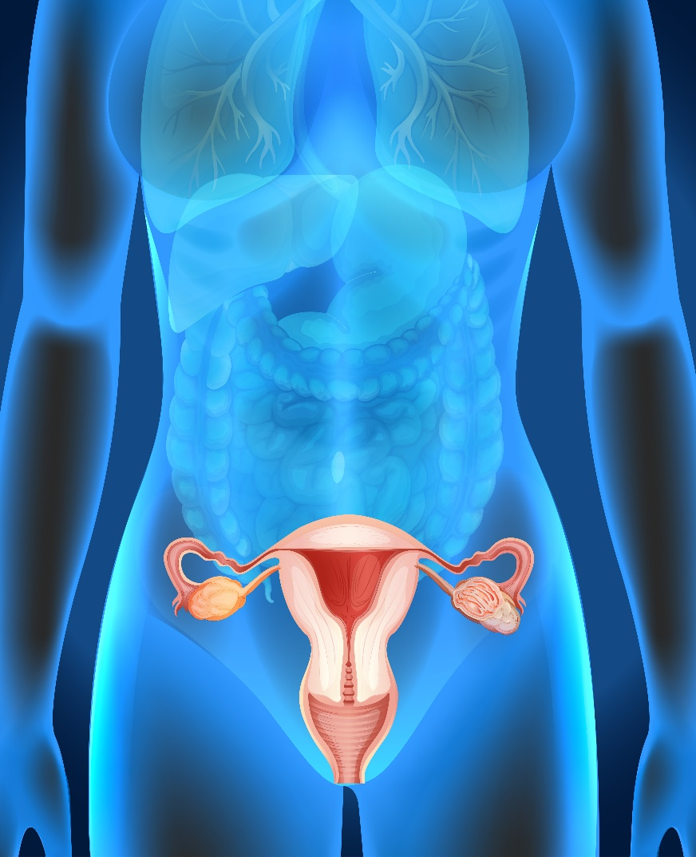
Alberta Endometrial Cancer Cohort Study (2002-2019)
Participants:
Recruited from a previously established case-control study
425 women with histologically-confirmed invasive endometrial cancer
Eligibility criteria:
  30-80 years of age
  English-speaking
  Able to complete in-person interview
  No previous history of non-melanoma skin cancer
Physical activity assessment:
Lifetime Physical Activity Questionnaire (LTPAQ)
  Administered by trained interviewers using recall calendar
  Captured:
    Frequency, intensity, duration of physical activity
    Domain: total, recreational, occupational, household
Friedenreich CM et al. JCO 2020 (in press)

Slide 17
Alberta endometrial cancer cohort: Study Design
Medical chart abstractions
Diagnosis
(0 months)
N = 549
Baseline assessment
(median 4.4 months)
N = 541
Follow-up assessment
(median 3.4 years)
N = 425
End of follow-up
(median 14.5 years)
N= 425
2002-2006
2006-2011
2019
Pre-diagnosis physical activity
Post-diagnosis physical activity
LTPAQ
(childhood to diagnosis)
& Covariates
LTPAQ (diagnosis to time of follow-up assessment)
& Covariates
Friedenreich CM et al. JCO 2020 (in press)

Slide 18
Results: Pre-diagnosis physical activity
DFS = disease-free survival; Overall = overall survival
Friedenreich CM et al. JCO 2020 (in press)

Slide 19
Results: Post-diagnosis physical activity
DFS = disease-free survival; Overall = overall survival
Friedenreich CM et al. JCO 2020 (in press)
Notes:
Removed household and occupational rows.
Removed column with age-adjusted results.

Slide 20
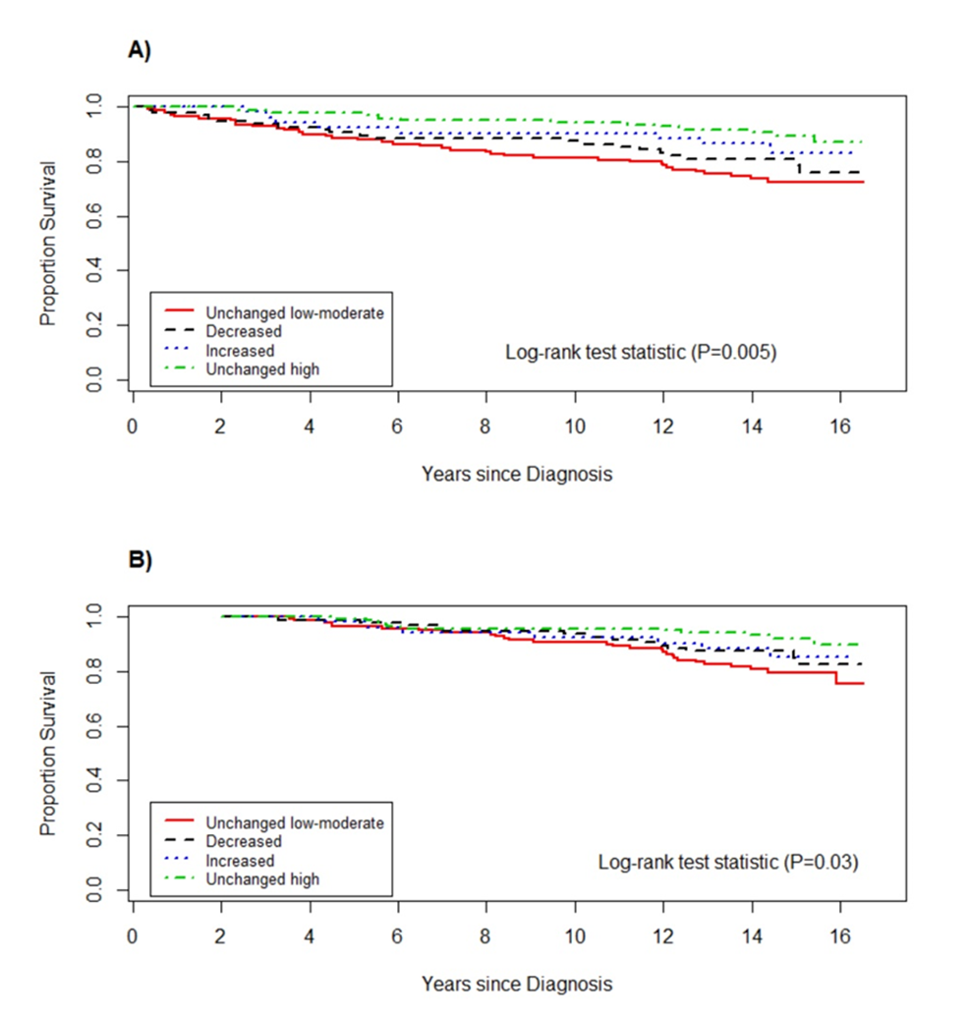
A) Disease-free survival
Results:
Change from pre- to post-diagnosis recreational PA
B) Overall survival
Friedenreich CM et al. JCO 2020 (in press)
Notes:
Kaplan-Meier curves for: A) disease-free survival and B) overall survival among endometrial cancer survivors based on change in recreational physical activity from pre- to post-diagnosis.
Cut point for low vs. high was 10 MET-hour/week/year
Need figure with better resolution.

Slide 21


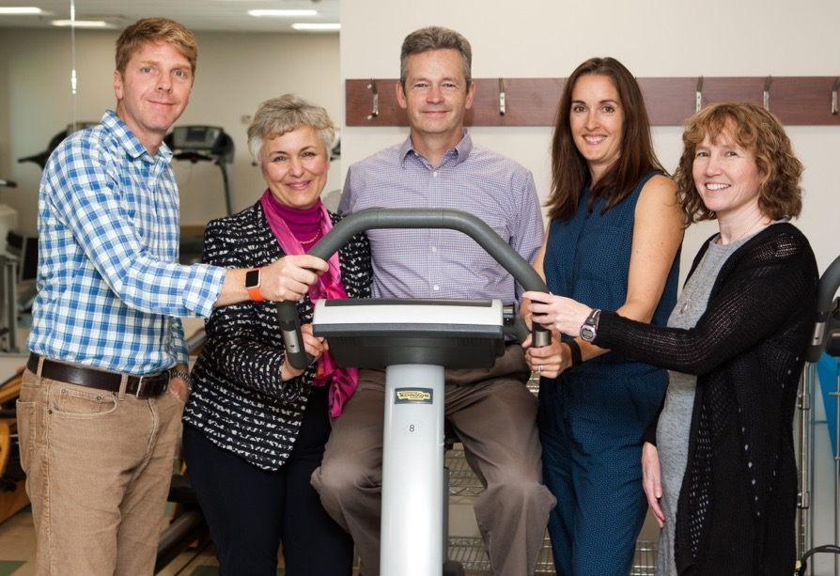

Alberta Moving Beyond Breast Cancer (AMBER) Cohort Study
Research Team Leads:
Courneya KS (co-PI)
Friedenreich CM (co-PI) Vallance J
Culos-Reed N
McNeely M
AMBER Study Participant:
Louise Jeffries
Funded by CIHR, 2011-2023

Slide 22
Study timeline & design
2011-2017
2018-2023
Enroll 1500 incident Stage I-IIIc breast cancer cases
How can physical activity and health related fitness be used to inform clinical recommendations for improving patient-related outcomes and survival in breast cancer survivors?
Measure physical activity, health-related fitness, determinants of PA, patient-related outcomes, biomarkers, lymphedema
Repeat baseline measurements at 1, 3 and 5 years post-diagnosis
Follow-up for mortality outcomes (disease-specific and all cause)

Slide 23

Progress to date
Newly diagnosed breast cancer cases May 2012 – June 2019 (n=14,680)
Eligible and approached for study (n=3,673)
Completed baseline assessments (n=1,528)
Completed 1-year follow-up assessments (n=1,252)
Completed 3-year follow-up assessments (n=779)
Completed 5-year follow-up assessments (n=388)

Slide 24
Selected baseline characteristics
Characteristic | Total population (n=1528)
Age at diagnosis | 55.2 ± 10.9
University education | 77.5%
Postmenopausal | 60.9%
Weight, kg | 73.8 ± 15.9
Body mass index, kg/m² | 27.5 ± 5.6
Cancer stage
Stage I | 45%
Stage II | 47%
Stage III | 8%
Cardiorespiratory Fitness (mL/kg/min)
Poor | 68.6%
Fair | 13.8%
Good | 11.3%
Excellent | 6.3%

Slide 25
Integration of Initial Projects
Project #5: Culos-Reed PI
Determinants of PA and HRF
Project #3: Vallance PI
PA, HRF, and PROs
Project #4: McNeely PI
PA, HRF, and Lymphedema
Supportive Care
Endpoints
Quality of life
Psychosocial functioning
Symptom management
Lymphedema
Covariates
Demographic
Medical
Biological
Functional
Body composition
Behavioral
Psychosocial
Environmental
Exposures
Physical activity
Health-related fitness
Mechanisms
Biomarkers
Treatment/Disease
Endpoints
Treatment decisions
Treatment completion
Treatment response
Disease-free survival
Cancer-specific mortality
Overall survival
Project #1: Courneya PI
PA, HRF, and Disease Endpoints
Project #2: Friedenreich PI
PA, HRF, and Mechanisms
PA: Physical activity
HRF: Health-related fitness
PROs: Patient-reported outcomes
Courneya et al., BMC Cancer 2012, 12:525

Slide 26
Hypothesized biologic mechanisms for physical activity, fitness and breast cancer outcomes
Oophorectomy, ovarian ablation, CT can induce menopause
BODY FAT
Ovaries premenopause
Increased breast
cancer mortality and recurrence
HT affects bone mineral density; CT, HT may ↑ fat mass
HT
HT
PA
↑ BMI
↑ body weight
↑ androgens
↓ SHBG
↑ estrogens
↓ SHBG
HRF
↑ leptin
↓ adiponectin
PA
↑ insulin
CT
HRF
↑ TNF-α
↕
↑ IL-6
↑ C-reactive protein
↑ IGF-I
↓ IGFBP-3
PA
PA
INSULIN
RESISTANCE
INFLAMMATION
CT- chemotherapy; HRF- health-related fitness; HT- hormone therapy; PA - physical activity

Slide 27

Team grant funded by CIHR, CCS, CBCF
Quan ML, Narod S (co-PIs)
A prospective cohort of 1,500 new breast cancer cases aged 18-40 started in 2015
33 recruitment sites across Canada.
1 200 recruited to date

Slide 28

On-going RCTs of exercise and cancer survival

Slide 29
Colon Health and Life-Long Exercise Change (CHALLENGE) Trial
Histologically confirmed operable colon cancer
>60 - <180 days post adjuvant tx
Baseline Assessment
N=962
R
ANDOM
I
Z
A
T
I
ON
E
N
D
O
F
S
T
U
D
Y
Physical activity program + general health materials (supervised PA + counselling)
Progressive Disease
or
Unacceptable toxicity
or
withdrawal of consent
General health materials
(usual care)
3 years
Primary: disease-free survival
Secondary: PROs, functional capacity, etc.
Courneya et al. Curr Oncol, 2008;15:262-70
Courneya et al. Cancer Epidemiol Biomark Prev , 2016;25:969-77

Slide 30
Global Action Plan 4 - INTense Exercise foR surVivAL among men with Metastatic Castrate-Resistant Prostate Cancer (INTERVAL)
Metastatic castrate resistant prostate cancer
Baseline Assessment
N=866
22 centers in 8 countries
R
ANDOM
I
Z
A
T
I
ON
12 month supervised aerobic and resistance exercise + behavioural and psychosocial support and 12 month home-based program
E
N
D
O
F
S
T
U
D
Y
SURVIVAL
Psychosocial support
2 years
Primary Outcome: Overall survival, progression free survival
Secondary Outcomes : PROs, functional capacity, metabolic biomarkers, skeletal progression, pain, etc.
Newton RU, et al. BMJ Open 2018;8:e022899.

Slide 31


Physical activity and cancer survival: summary
Evidence suggests physical activity predicts survival in at least 11 cancer types
Sufficient evidence published for breast, colorectal and prostate cancers, however limited evidence exists for most other cancer sites
Both pre- and post-diagnosis physical activity provide improved mortality outcomes.
  However, post-diagnosis physical activity has larger effect sizes (HRs ~ 0.6 versus 0.8)
Non-linear dose-response relationships between physical activity dose and mortality
On-going cohort studies and RCTs will provide more definitive data on the dose, timing, domain of activity related to survival outcomes

Slide 32
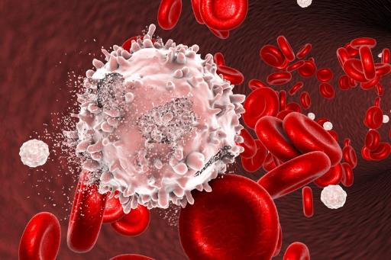

Biologic mechanisms in physical activity and cancer survival

Slide 33
Hypothesized biomechanisms relating aerobic and resistance exercise to postmenopausal breast cancer risk
↓ total body fat
↓ bioavailable estrogens
Aerobic Exercise
↑ SHBG
↓ Risk
of Post-
meno-
pausal Breast Cancer
Resistance Exercise
RE
AE
↓estradiol, ↓ estrone
↓ leptin
←RMR
RE
AE
RE
AE
↓ pro-inflammatory cytokines (IL-6, TNF-α)
↓ low-level systemic inflammation
Aerobic Exercise
↓ intra-abdominal fat
Resistance Exercise
↑adiponectin
↓ C-reactive protein
←RMR
RE
AE
↑ insulin sensitivity
↑ myokines
(anti-inflammatory)
↑ skeletal muscle
Resistance Exercise
↑ GLUT4 protein
↓ insulin, ↓ glucose,
↓ HOMA-IR
Convincing evidence
RMR, resting metabolic rate
Limited or inconsistent evidence
, possible exercise effect independent of body composition change
RE
AE

Slide 34





Canadian exercise intervention trials
N = 320 postmenopausal women 50-74 yrs
Exercise group: one year of 225 min/week
Control group: no changes
Exercise resulted in greater decreases in endogenous sex steroid hormones, insulin resistance, inflammation, adiposity levels. No changes for mammographic density
Found greater decreases in biomarkers among women who were most adherent
N = 400 postmenopausal women 50-74yrs
High volume: 5 days/wk x 60 min session (300 min/wk)
Moderate volume: 5 days/wk x 30 min session (150 min/wk)
High volume group had greater reductions in adiposity
Both groups experienced decreases in endogenous sex hormones, inflammatory markers, insulin resistance

Slide 35
International exercise intervention trials
PATH Trial (McTiernan et al), USA
12-month, Aerobic Exercise vs Control
N=173
SHAPE-1 (Monninkhof et al), NL
12-month, Group Exercise vs Control
N=189
NEW Trial (McTiernan et al), USA
12-month, 4-arm trial of exercise and diet
N=439
SHAPE-2 (van Gemert et al), NL
16-week, 3-arm trial of diet and exercise
N=240
These trials all found decreases in biomarkers associated with cancer in the exercise group and these changes were even greater when diet was also modified

Slide 36

Hypothesized biologic mechanisms for physical activity and cancer outcomes
Additive or synergistic effects
Cancer Treatment
Adherence to treatment
Patient genetics & tumor subtype
Drug distribution, metabolism
Cancer Diagnosis
Prostate
Breast
Colorectal
Body Fat
pro-inflammatory cytokines, leptin, adiponectin, insulin resistance indicators, aromatase
Recurrence &
Mortality
Body Composition
Skeletal muscle
anti-inflammatory myokines, insulin sensitivity indicators
Bioavailable sex hormones
Insulin sensitivity
Biomarkers
Chronic low-grade inflammation
Immuno-surveillance
DNA damage
Suppression of cancer cell viability
Friedenreich, et al. J Molecular Mechanisms 2017;95:1029-41 (Updated)

Slide 37





Model of impact of physical activity mechanisms in colorectal carcinogenesis
Incidence
Treatment
Recurrence
Progression
COLORECTAL CANCER-SPECIFIC death
Stage
I
Stage
II → III
Stage
IV
Aberrant crypt foci
Adenoma
Adeno-carcinoma
Aberrant crypt foci
Adenoma
Adeno-carcinoma
Normal Tissue
Normal Tissue
Field cancerization
Field cancerization
Untreated ACF
Possible PA association: advanced adenoma
Convincing PA association: adenocarcinoma
Possible PA association: adenoma recurrence (men)
Probable PA association: cancer-specific death
Physical Activity During Treatment
Pre-diagnosis Physical Activity
Post-diagnosis Physical Activity
Known pathway
Hypothesized pathway
Friedenreich CM, et al. J Molecular Mechanisms 2017;95:1029-41
Notes:
Colorectal cancer serves as a useful case study for studying physical activity mechanisms because risk accumulation is observable. The overall strength and consistency of epidemiologic evidence relating physical activity to colorectal cancer outcomes is strongest for colorectal cancer incidence, somewhat weaker for colorectal cancer mortality (given fewer prospective studies; although results have been relatively consistent, generally showing benefit from both pre- and post-diagnosis physical activity), and weakest for adenoma (polyp) recurrence, due to limited epidemiologic research focused on recurrence outcomes and studies showing significant associations only in men. Solid arrows indicate known pathways. Broken arrows indicate hypothetical pathways.

Slide 38
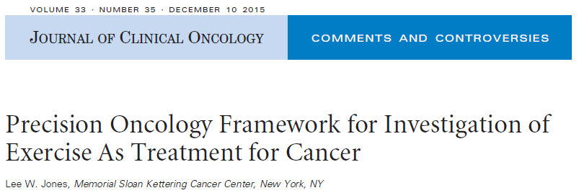
Discovery
Biomarker-driven clinical trials
Definitive clinical trials
Evaluation of Causality
Molecular epi studies
Preclinical Testing
Safety and Tolerability Trials
Are there molecular subgroups of patients who are responders/non-responders to exercise?
Jones LW, J Clin Oncol 2015;33:4134-7.
Notes:
In fact all of these types of studies are happening concurrently, even clinical trials e.g., CHALLENGE.

Slide 39
Precision exercise oncology research
EXERCISE
3. Molecular Epidemiology Studies
PATIENT SUBGROUPS
Based on:
ER (breast)
HER2 (breast)
CTNNB1 (colon)
p27 (colon)
IRS1 (colon)
others
Body Fat
BIOMARKERS
Insulin
IGF-1
CRP
Gene Expression
Others
Sex hormones
Insulin sensitivity
Chronic low-level inflammation
2. Exercise RCTs
Protective effect
May be exercise-responsive
No protective effect
May be exercise-resistant
Other mechanisms: modifiable and non-modifiable
BIOLOGIC MECHANISMS
1. Observational Studies
RECURRENCE SURVIVAL
Friedenreich CM, et al. Clin Cancer Research 2016; 22: 4766-75
Notes:
Design of molecular epi studies requires careful selection of tumor markers. A tumor marker represents a biologic mechanism through which exercise improves survival and its presence or absence predicts efficacy (analogous to a drug). Particularly in this case, several types of epidemiologic evidence can inform tumor marker selection.
Prospective cohort or case-control studies of cancer patients can add to preclinical research to clarify the biologic mechanisms influencing cancer survival (#1). Mechanisms most often studies in exercise oncology include: sex hormones, insulin-related pathways, low-level chronic inflammation. Oxidative stress, immune function and adipokines are also commonly studied. The relative influence of each pathway and their combined effects on cancer survival are unknown. The clear overlap between these mechanisms and those for obesity and cancer are also noteworthy which raises the question of whether or not a lifestyle intervention designed to induce weight loss might provide greater survival benefit than exercise alone, at least for some tumor sub-types.
RCTs of exercise can be used to demonstrate exercise modes of action using cancer survival biomarkers as endpoints (#2). Exercise trials in cancer patients have measured insulin, adipokines, IGFs, anti-inflammatory markers, immune function, oxidative stress, PSA, testosterone. More recently, tumor gene expression, epigenetic mechanisms, DNA damage, telomerase activity. RCTs can determine causal effects of exercise on biomarkers and can compare different types, doses, durations, timing of exercise which can define exercise prescription.
Molecular epi studies can generate compelling hypotheses (#4) to guide large scale Phase III trials incorporating precision exercise questions. Hypotheses may also flow from primary prevention studies e.g. ER/PR, HER2, p53 and BRCA mutations have been studied in relation to br ca risk and CTNNB1 and genetic variants in the IGF pathway have been studied w.r.t. CRC risk. Studies of pre-diagnosis PA and interactions with BRAF mutations, KRAS mutations and MSI status were explored recently (Hardikar, 2015).

Slide 40


Future directions

Slide 41
Main topics for future research
Observational epidemiologic studies of PA and SB for both prevention and survival on understudied sites and sub-sites and types
Randomized controlled intervention trials across the cancer continuum that include objective measurements of PA, SB and health-related fitness
Clinical/pathologic characteristics to be considered
Molecular and biologic mechanisms between PA and cancer including novel pathways (e.g. gut microbiome)
Role of PA and SB and cancer within population sub-groups
Pragmatic behaviour modification trials
FITT recommendations for cancer prevention, rehabilitation and survival

Slide 42

Take home messages
More research needed for exercise prescriptions for cancer survival
PA is beneficial for cancer outcomes but many knowledge gaps remain for several cancer sites
Population sub-groups and molecular mechanisms need to be examined
Clear messaging to the public and health professionals needed
Evidence on SB and cancer outcomes just emerging

Slide 43

Thank you for your attention
Questions?

